Slide 1

What are we going to see in this session?
How Git works?
Git Installation

Slide 2

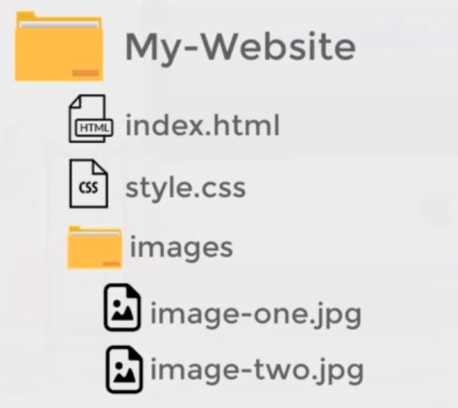
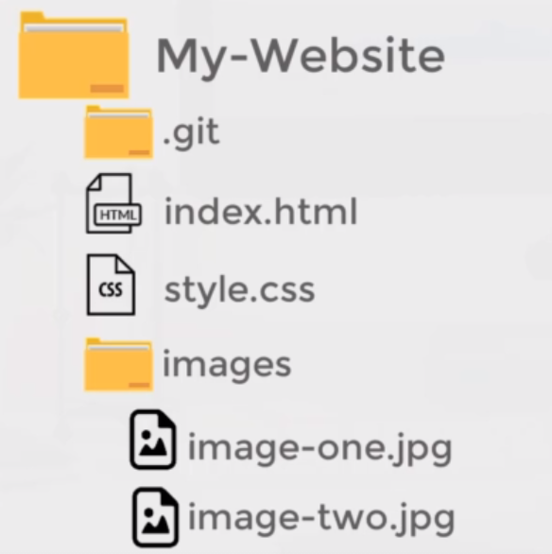
How Git works ?
In order to use Git for your project, first of all you may need to initialize it.
Lets assume you have project folder called My-Website.
You can do git initialize in that folder which will create folder (.git)
Once initialization is done the entire folder will be considered as an repository.

Slide 3
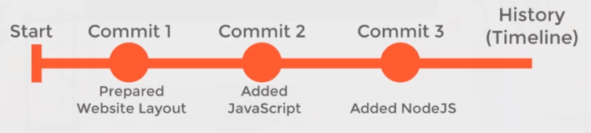
How Git works ?
Lets see how its going to track all the files under the project folder.
Commit 1 would be the first version of your project files.
Commit 2 & Commit 3 is going to have updates files of your project.
Also you can switch between the versions (also called snapshots) when and where required.

Slide 4
Git Installation
To commit any file from your machine, you may need to install git first.
You can visit official git link to download git.
Git can be installed in Windows/Mac/All Linux Distributions.
If you are going to use windows – “Git bash” tool would be very helpful to deal with git repositories.
If you are going to use Linux, all things can be done from the command line.

Slide 5

End of this topic !
Any questions?

